Slide 1
ADDRESS BOOK SYSTEM
Using C++ • Object-Oriented Programming
CAPSTONE PROJECT – REVIEW
PRESENTED BY:
LAKSHMI SRIKAR
CHINTA SANTOSH REDDY
NAKSHATRA CHAKRAM
CHOWDARY YASHWANTH

Slide 2
Project Overview
A practical C++ solution for organized contact management
The Address Book System is a menu-driven console application designed to store, organize, search and manage contact information efficiently.
CONTACT DATA
SEARCH
ORGANIZATION
DATA
Name • Phone • Email
Name • Phone • Email
Category • Favorite
File • Backup • CSV
FINAL SYSTEM CAPABILITIES
CRUD OPERATIONS
SEARCH & SORT
VALIDATION
PERSISTENCE
BACKUP
CSV EXPORT

Slide 3
Problem Statement
Why is a dedicated system needed?
Large contact lists are difficult to manage manually.
Finding a specific contact can become time-consuming.
Updating or deleting outdated records is inconvenient.
Duplicate or invalid information can reduce data reliability.
Contact records need organized and persistent storage.

Slide 4
Project Objectives
01
ORGANIZE
Store and manage contact information efficiently.
02
MANAGE
Add, view, search, update and delete contacts.
03
ORGANIZE FURTHER
Sort, categorize and manage favourite contacts.
04
VALIDATE
Prevent invalid and duplicate contact records.
05
PRESERVE
Provide file storage, backup and CSV export.
06
APPLY C++
Demonstrate OOP and C++ concepts in a practical application.

Slide 5
Implemented Modules
CONTACT MANAGEMENT
SEARCH
ORGANIZATION
Add , View , Update , Delete
Name , Phone , Email
Sort , Category
FAVORITES
STATISTICS
DATA MANAGEMENT
Mark , Unmark , View
Contact summary
File , Backup , CSV
VALIDATION
Format checks , Duplicates

Slide 6
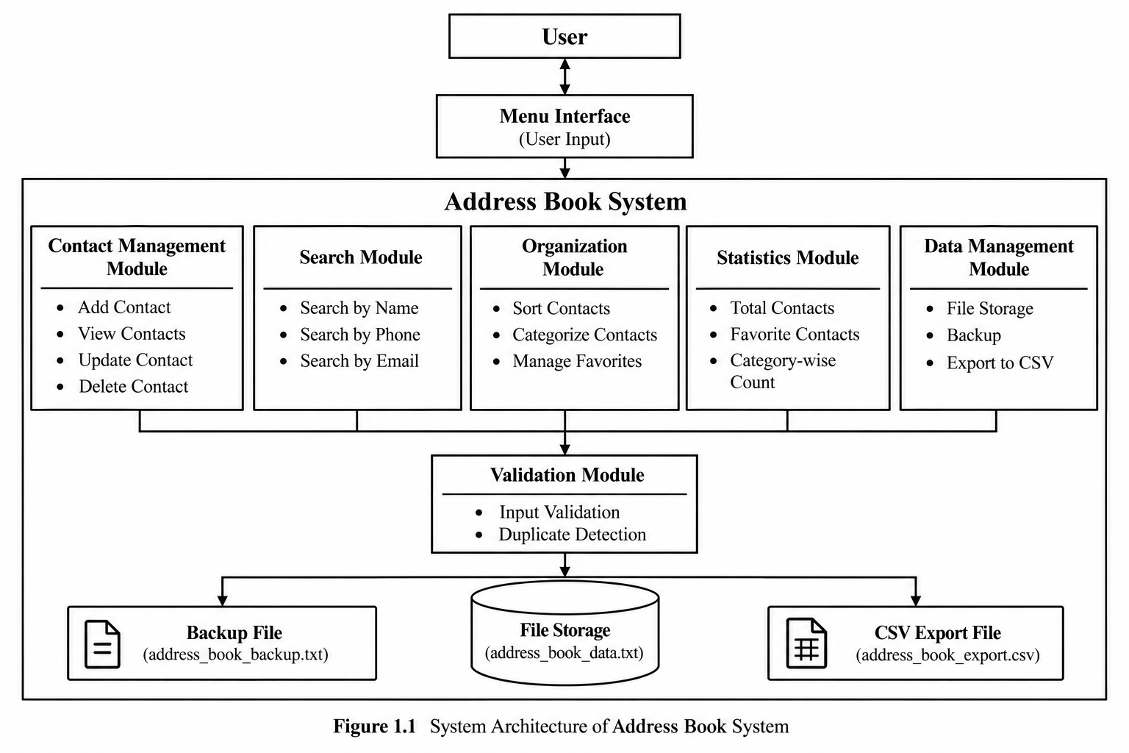
System Architecture

Slide 7
System Workflow
1
Load Stored Contacts
2
Display Main Menu
3
Select Operation
4
Validate Input
Read contact data from file
Show available operations
User chooses an option
Check format and duplicates
5
Perform Operation
6
Update Contact Data
7
Save to File
8
Display Result
Add / View / Search / Update / Delete/
Sort / Category / Favorites / Statistics
Modify the selected record in memory
Store changes in address_book_data.txt
Show success message or output
10
Exit
9
Return to Menu
End the application
Continue with another operation

Slide 8
Object-Oriented Design
CLASS 1
CLASS 2
AddressBook
Contact
Represents one contact record.
Data:
• contactID
• name / phone / email
• address / category
• notes / favorite / createdAt
Behavior:
Display contact details
Update contact information
Manage favourite status
Manages the complete collection of contacts.
Data:
• vector<Contact> contacts
• nextID
Behavior:
Add and display contacts
Search and update contacts
Delete contacts
Sort and filter contacts
Manage favorites
Save and load contact data

Slide 9
C++ Concepts Used
OOP
STL
Classes & Objects
Encapsulation
Constructors
Member Functions
vector<Contact>
std::sort()
Algorithms
PROGRAMMING
DATA HANDLING
Strings
Loops
Conditions
Switch-case
ifstream / ofstream
stringstream
Regular Expressions

Slide 10
Key Implementation
ADD + STORE CONTACT
Contact newContact(
nextID, name, phone,
email, address, category
);
contacts.push_back(newContact);
nextID++;
saveToFile();
Creates a new contact object with the entered details, adds it to the contact list, assigns a unique ID, and saves the updated contact information to the file.
SEARCH
getName().find(keyword)
getPhone().find(keyword)
getEmail().find(keyword)
// display matching contact
Searches the stored contacts by name, phone number, or email and displays the contact details when a matching record is found.

Slide 11
Organization Features
CATEGORY
FAVORITES
SORTING
std::sort()
getCategory()
favorite = true / false
Contacts are arranged alphabetically by name.
The system filters records according
to the selected category.
ToggleFavorite() changes
the status and
viewFavorites() displays only
marked contacts.
This improves navigation and keeps
the list organized
Example: College , Family ,
Friends , Work
These features extend the system beyond basic CRUD operations.

Slide 12
Persistent Data Management
PROGRAM RUNS
ADDRESS BOOK
DATA FILE
loadFromFile()
address_book_data.txt
LOAD
SAVE
ifstream infile(filename);
while (getline(infile, line)) {
// read stored record
}
ofstream outfile(filename);
outfile << nextID << "\n";
// write contact records
outfile.close();
Additional data management: Backup Contacts • Export Contacts to CSV
Result: contact information remains available after the application is closed and reopened.

Slide 13
Testing & Validation
TEST CASE
INPUT
EXPECTED RESULT
TYPE
STATUS
Add Contact
Valid contact details
Contact added successfully
Functional
PASS
PASS
Invalid Phone
12345
Error message displayed
Negative
PASS
PASS
Invalid Email
abc@
Invalid email rejected
Negative
PASS
PASS
Duplicate Phone
Existing number
Duplicate contact rejected
Negative
PASS
PASS
Search
Existing name
Matching contact displayed
Functional
PASS
PASS
Update
Valid Contact ID
Contact details updated
Functional
PASS
PASS
Delete
Valid ID + confirmation
Contact removed
Functional
PASS
PASS
Category
College
Matching contacts displayed
Functional
PASS
PASS
Favorite
Contact ID
Favorite status updated
Functional
PASS
PASS
Persistence
Restart program
Stored data retained
Functional
PASS
PASS
Negative tests confirm that invalid and duplicate inputs are handled safely without corrupting contact data.

Slide 14
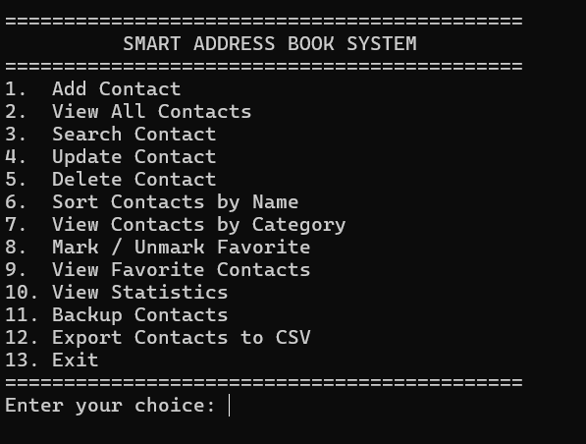
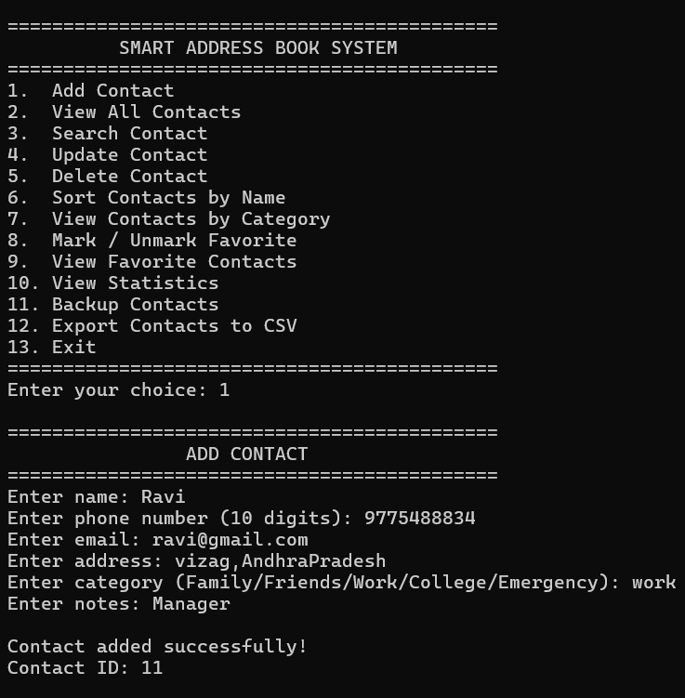
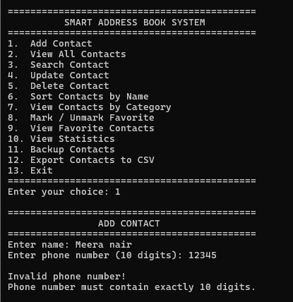
Final Output & Demonstration
MAIN MENU
ADDING CONTACT
VALIDATION

Slide 15
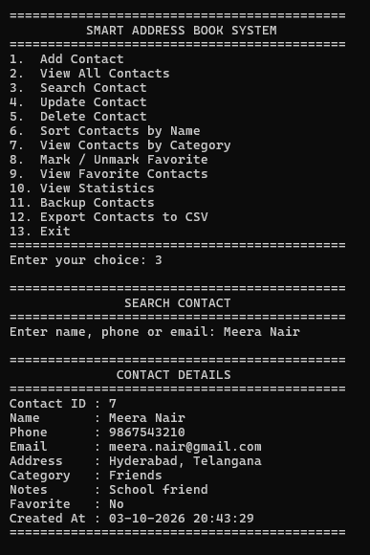
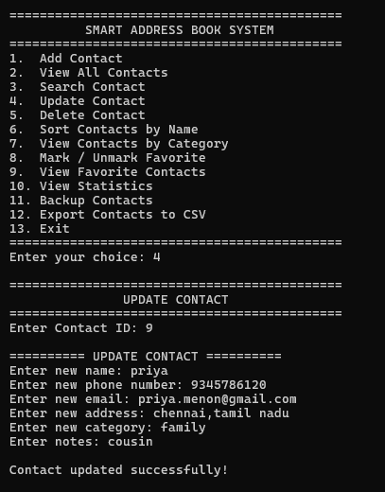
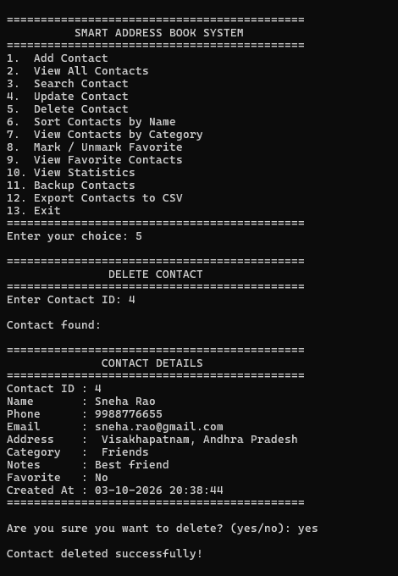
UPDATE CONTACT
DELETE CONTACT
SEARCH CONTACT

Slide 16
Final Implementation Status
Core Functionality
Add, view, search, update and delete contact records.
Contact Organization
Contacts can be sorted, categorized and marked as favourites.
Validation & Data Accuracy
Input validation and duplicate detection prevent incorrect records.
Persistent Data Management
Contact information is stored in files and retained after restarting the program.
Data Backup & Export
Contact records can be backed up and exported in CSV format.
Testing & Validation
Functional, invalid-input and duplicate-entry test cases were performed successfully.
C++ Concepts Successfully Applied
OOP, STL, file handling, strings, regular expressions, loops, conditions and switch-case were implemented.
The Address Book System has been successfully implemented, tested and demonstrated as a functional C++ console application.

Slide 17
CONCLUSION & FUTURE SCOPE
CONCLUSION
The Address Book System provides an organized and efficient solution for managing contact information
while demonstrating practical C++ and Object-Oriented Programming concepts.
FUTURE SCOPE
• Graphical user interface
• Database integration
• Advanced multi-field search
• Contact import and synchronization
• Reminders and notifications

Slide 18


18

